Slide 1


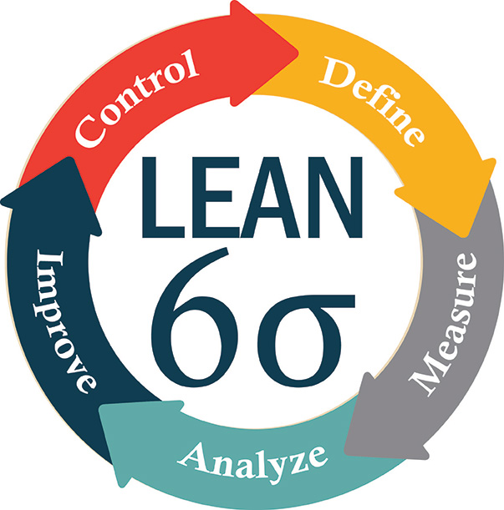

GENTECH BUSINESS SOLUTIONS
Lean
S
Case study
ix
igma
Team 361 - DATA DYNAMO
Ben Jose
Omkarini Tirumalaraju
Shruthi Reddy Kolan
Balaji Raj Veluchamy

Slide 2






CASE STUDY INFORMATION
GENTECH IS A LARGE MULTINATIONAL COMPANY, WHICH COMPANY HAS BEEN A MARKET LEADER FOR SEVERAL YEARS.
Annual Revenue
$60 million
100 countries across the globe
Over 150 thousand employees & contractors
Software, Hardware & integrated business solutions

Slide 3


CASE STUDY - Expectations
INCREASE MARKET SHARE
Increase Profitability
Company Situation
Expected Improvement
18% reduction
Revenue
Reduce Cycle time by 15%
Cost effective Supply Chain
Meet Customer needs

Slide 4

Mission statement
"At Gentech, our mission is to empower businesses with cutting-edge technology solutions, driving innovation, and facilitating growth. We are dedicated to delivering excellence in software, hardware, and integrated business solutions while fostering a culture of continuous improvement. Our commitment to efficiency, agility, and customer-centricity enables us to meet the dynamic needs of our global clientele. We strive to be the industry leader, offering value-driven, sustainable solutions that fuel success and create lasting partnerships."

Slide 5



Gentech – Management driven team
Elliot Smith
Grace Monroe
Jeff Hugh
CEO
VP of Supply Chain Operations
LSS Black Belt

Slide 6


Gentech’s proposal creation process is burdened by substantial inefficiencies and an SLA compliance rate of only 72.32%, which has led to adverse consequences for the company, including a significant impact on the overall bid size, standing at $2.49 billion. These challenges are contributing to increased operational costs, reduced revenue potential, and diminished customer satisfaction.
Problem Statement
Goal Statement
The objective is to substantially improve the efficiency of Gentech's proposal creation process by increasing the proportion of SLA in cycle time, currently at 72.32%, to 90% by the end of the fourth quarter in 2023. This improvement will enhance competitiveness, lower operational costs, and increase customer satisfaction.

Slide 7


Voice of the Customer
Customers :
Clients those who quote for best products & better services (software, hardware, business solutions) from the Gentech through the sellers in an effective and efficient way of relationship to be part of business.
Voice of the Customer :
Gentech's customers seek high-quality, efficient, and cost-effective software, hardware, and business solutions. They expect timely responses, effective communication, and reliable, customized offerings to meet their specific needs. Gathering and analyzing customer feedback is vital to ensuring that Gentech aligns with these key customer expectations.

Slide 8
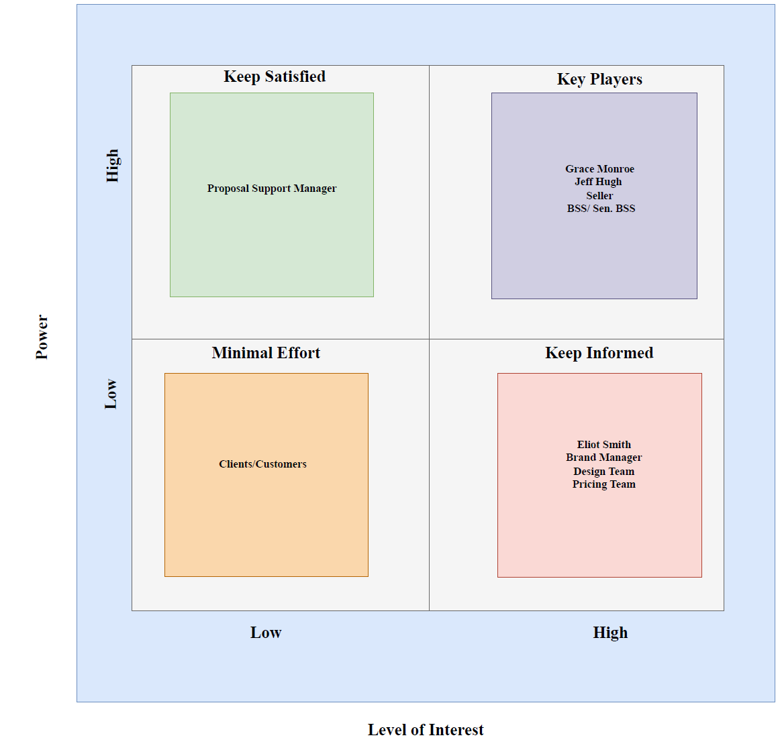
Stakeholder analysis
Our stakeholder analysis highlights the diverse group of individuals involved in our Gentech project, spanning from top management down to operational staff. This analysis evaluates their influence (POWER) on the project's outcomes and their level of engagement and concern (INTEREST) in the project's success. Recognizing the unique needs and expectations of each stakeholder is critical for effectively managing and implementing process improvements.

Slide 9
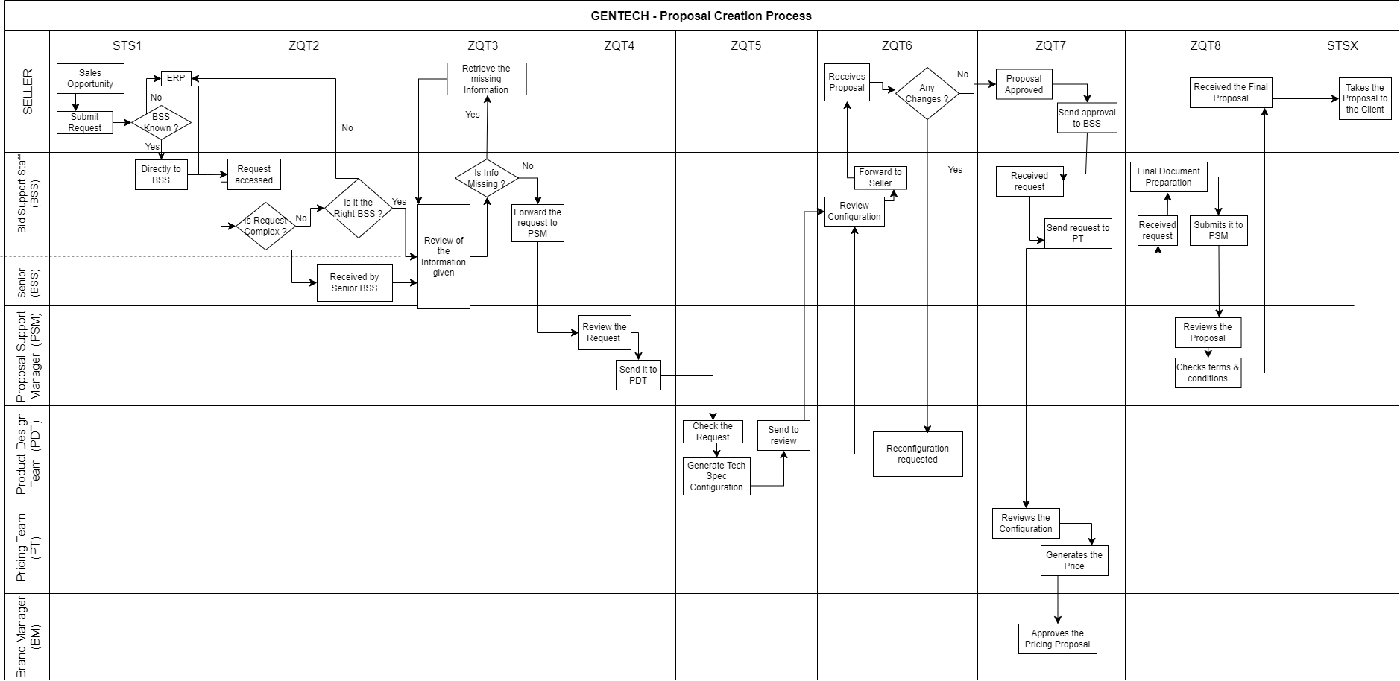
PROCESS MAP
Total Cycle Time from Request preparation to proposal submitted to client.
Request submission stage
Quote Creation process
Pricing stage
Documentation stage
Delivery stage
1.9 days
2 days
3 days
3.6 days
2 days
7.4 days
3.1 days
6.5 days
2 days

Slide 10
PROJECT GANTT CHART
MEASURE
Collect Data from Sales Transaction Dataset
Calculate Baseline Cycle Times
Determine DPMO and Sigma Level
Analyse Variations in Cycle Times
IMPROVE
Generate Recommendations
Implement Process Improvements
Monitor Changes in Performance
2023
JAN
FEB
MAR
APR
MAY
JUN
JUL
AUG
SEP
OCT
NOV
DEC
DEFINE
Establish Project Charter
Develop Process Map
Determine Metrics and Targets
ANALYZE
Identify Root Causes (5 Whys Analysis)
Analyze Brand and Geography Performance
Examine Bid Complexity vs. Cycle Time
Investigate Seller and Bid Support Staff Performance
CONTROL
Establish a Control Plan
Continuously Monitor and Measure Performance
Ensure Recommendations Are Effective
Sustain Process Improvements

Slide 11
Project Charter
Lean Six Sigma – Business Proposal Process Improvement
PROJECT TITLE |  | Optimizing Gentech's Proposal Creation Process for Enhanced Efficiency and Customer Satisfaction
START DATE |  | 09 / 02 / 2023 |  | PROJECT MANAGER |  |  | Jeff Hugh (LSS Black belt)
END DATE |  | 08 / 11 / 2023
PROJECT DESCRIPTION
Gentech, a global leader with a $60 billion annual revenue, is addressing an 18% revenue decline attributed to increased competition. CEO Elliot Smith has formed a task force to optimize the supply chain, targeting a 15% reduction in operational cycle times to improve market share and profitability. Additionally, Elliot has assigned Jeff to lead the overhaul of the bid proposal creation process, enhancing the company's competitiveness.
PROBLEM STATEMENT |  |  |  | GOAL STATEMENT
Gentech's proposal creation process faces inefficiencies, low SLA compliance at 72.32%, and impacts on a $2.49 billion bid size, resulting in higher operational costs, decreased revenue, and lower customer satisfaction |  |  |  | Enhance Gentech's proposal process by raising SLA compliance from 72.32% to 90% by Q4 2023, driving competitiveness, reducing costs, and improving customer satisfaction.
METHODOLOGY |  |  |  | DELIVERABLES
1. Lean Six Sigma methodology in DMAIC 2. Problem solving tools, Swimlane chart, Data Exploration. |  |  |  | Updated Process map with improved Cycle times resulting in increased Revenue.
TENTATIVE MILESTONES |  |  |  |  | Objective & Baseline
PARTICULARS |  |  | DURATION | DURATION | Reduce the SLA time taken for the Proposal creation. |  |  | Current Avg cycle time 32 days
Clarify the problem, set project goals, and identify key stakeholders |  |  | 2 - 4 weeks | 2
Gather data, establish baseline metrics, and assess the current state of the process. |  |  | 4 – 6 weeks |  | Benefits & Target
Examine data for patterns, root causes, and areas of improvement. |  |  | 6 – 8 weeks |  | Increase in Revenue Customer Satisfaction |  |  | Expected Avg cycle time 26 days
Implement changes, test solutions, and validate improvements. |  |  | 8 – 12 weeks |  | Increase in Revenue Customer Satisfaction
Establish control measures, monitor process performance, and sustain improvements |  |  | Continuous
PROJECT TEAM MEMBER
EXECUTIVE TEAM |  | PROPOSAL TEAM |  | PROPOSAL TEAM |  | PROJECT TEAM
CEO | Elliot Smith | PRODUCT DESIGN TEAM | PROPOSAL SUPPORT MANAGER | PRODUCT DESIGN TEAM |  | Ben Jose | PROPOSAL SUPPORT MANAGER | Omkarini Tirumalaraju
VICE PRESIDENT | Grace Monroe | PRICING TEAM | BSS/Sr. BSS | PRICING TEAM |  | Shruthi Kolan Reddy | BSS/Sr. BSS | Balaji Raj Veluchamy
LSS Black belt | Jeff Hugh | BRAND MANAGER | SELLER | BRAND MANAGER

Slide 12
KPI & Operational Definition
[Y = f(x)]
Approval Steps
Proposal Completeness:
Cycle Time
Complexity
Efficiency in Routing Requests
To improve the SLA %
Seller Handholding Time
Consistency Across Geographies
Non-standard Practices
Configuration Accuracy
SLA % = Service Level Agreement, ensures that the delivery cycle time for the proposal creation process is met within 35 days.
Pricing Approval Time

Slide 13





Data Collection & details
In this phase, our primary objective was to gather comprehensive data from Gentech's ERP system and Feedback from BSS, Sellers including Bid size details and timestamps. The dataset is about 3 years timeline with Year & Month, from 5 different geographical locations and for 5 different brands of the company with linked BSS and Seller.
2019
2020
2021
South America (SA),
Europe, Middle East, Africa (EMEA),
Japan (JPN),
North America (NA),
Asia Pacific (AP)
X Series Servers
Z Series Servers
ESW
Consulting Services
SWG (Software Group)
100 Bid Support Specialist available
Across globe.
[ 4 per Brand or 20 per Geolocation ]
25 Sellers available across globe.
5 per Geolocations for all brands.
75,000 rows(Transactions) & 20 columns(Features) of data with different process timestamps, Feedback from Seller & BSS with Transactions Bid Sizes.

Slide 14
Quality Metrics
Total Number of Samples = 75,000
No of Defects = 21,079
DPMO = 281053.33
Current Process Sigma level = 2.0797
Transactions with Cycle time above SLA limit ( > 35 days )
Whole transactions data collected from the ERP system.
!!!!

Slide 15
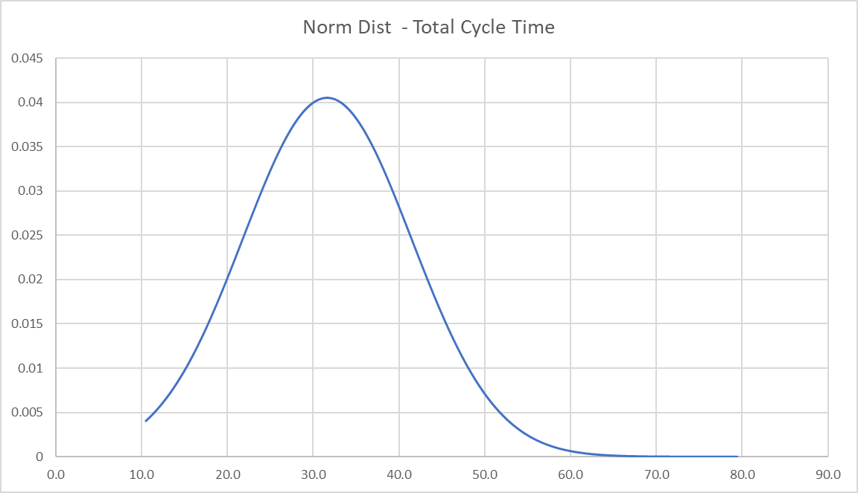
Data distribution of total cycle time
Mean | 31.6
Std Dev | 9.845
N | 75000
Z – Value
31. 5575 < X < 31. 6985

Slide 16
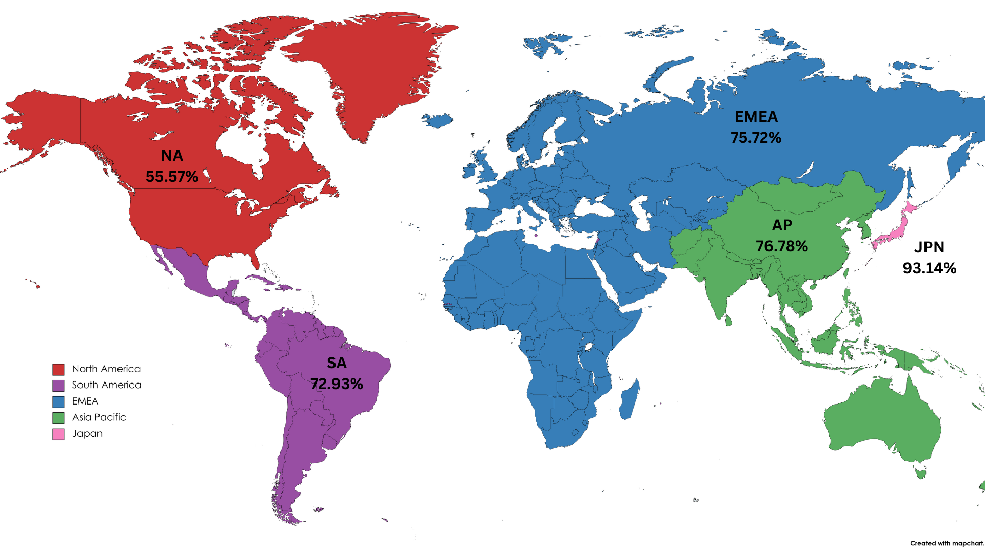
SLA COMPLIANCE RATE OF GEOGRAPHIES.

Slide 17
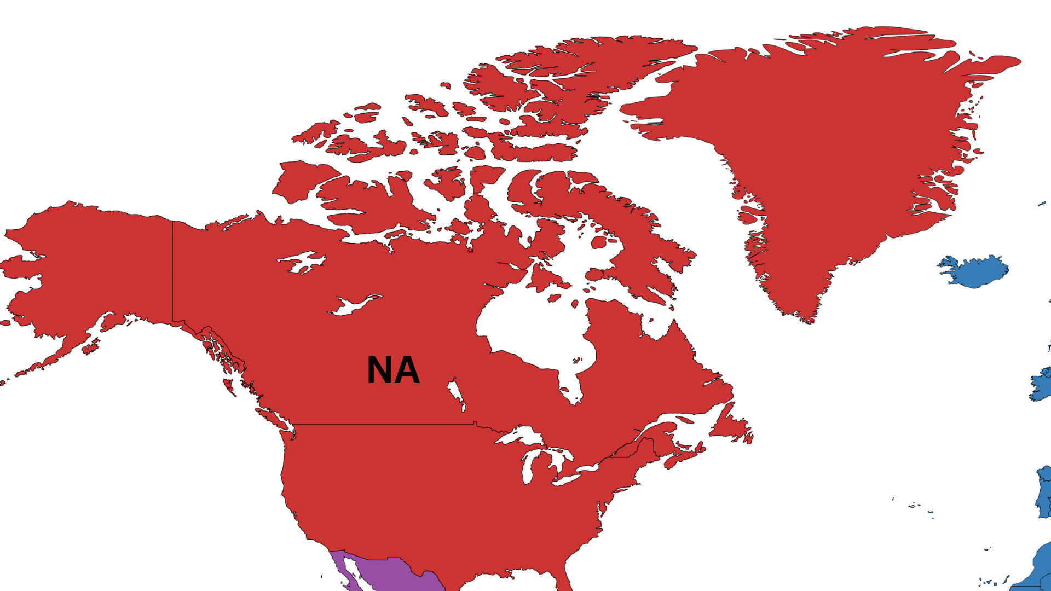
Quality Metrics
Current SLA | 55.57 %
Number of Defects | 8394
DPMO | 444291.5
AVERAGE CYCLE TIME
35.97 Days
REVENUE LOST
1.18 Billion

Slide 18
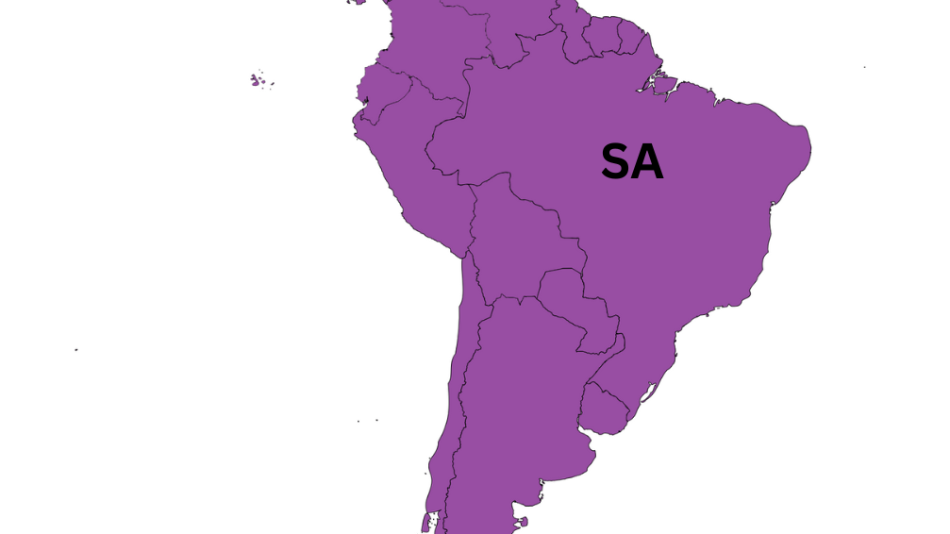
Quality Metrics
Current SLA | 72.93 %
Number of Defects | 4057
DPMO | 270737.4
AVERAGE CYCLE TIME
30.95 Days
REVENUE LOST
0.41 Billion

Slide 19
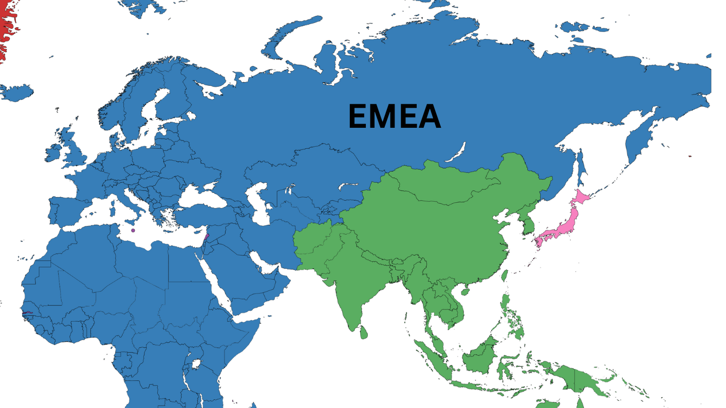
Quality Metrics
Current SLA | 75.72 %
Number of Defects | 4545
DPMO | 242840.4
AVERAGE CYCLE TIME
30.21 Days
REVENUE LOST
0.43 Billion

Slide 20
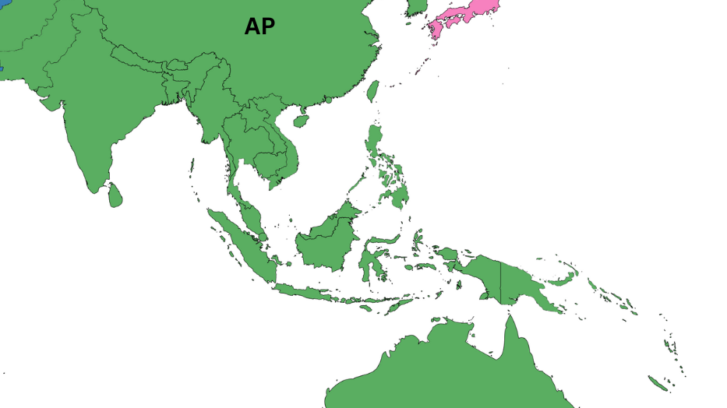
Quality Metrics
Current SLA | 76.78 %
Number of Defects | 3473
DPMO | 232152.4
AVERAGE CYCLE TIME
30.76 Days
REVENUE LOST
0.42 Billion

Slide 21
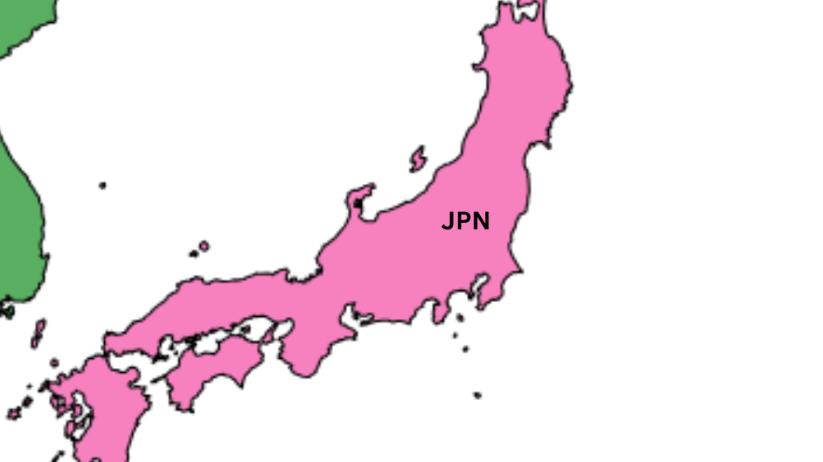
Quality Metrics
Current SLA | 93.14 %
Number of Defects | 511
DPMO | 68627.45
AVERAGE CYCLE TIME
27.24 Days
REVENUE LOST
0.04 Billion

Slide 22
SLA COMPLIANCE RATE OF GEOGRAPHIES.
Manila

Slide 23
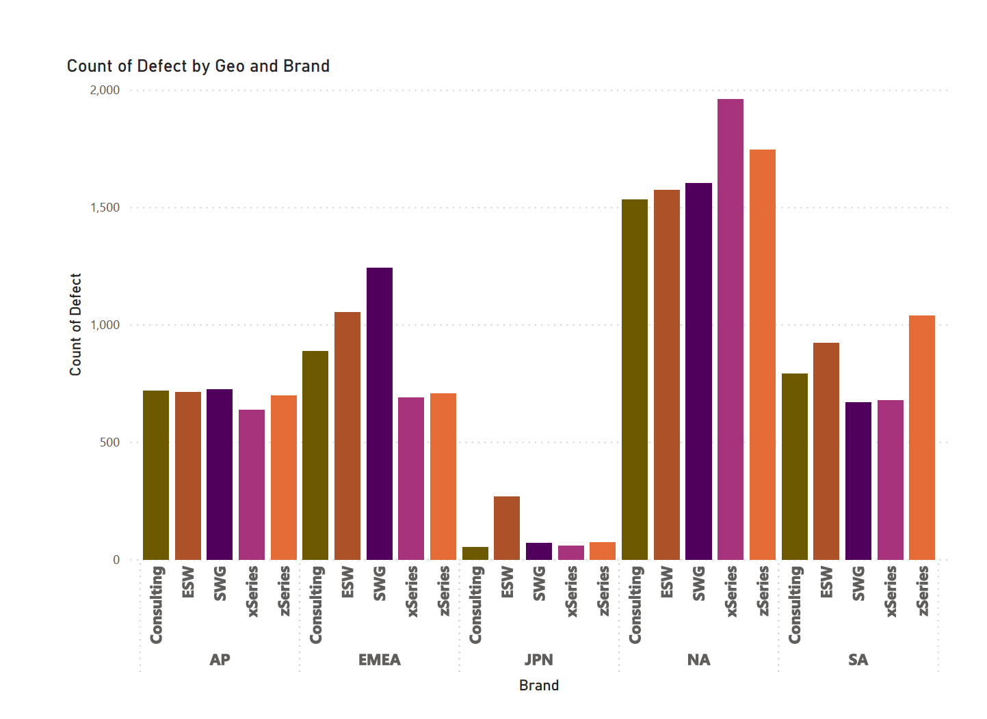
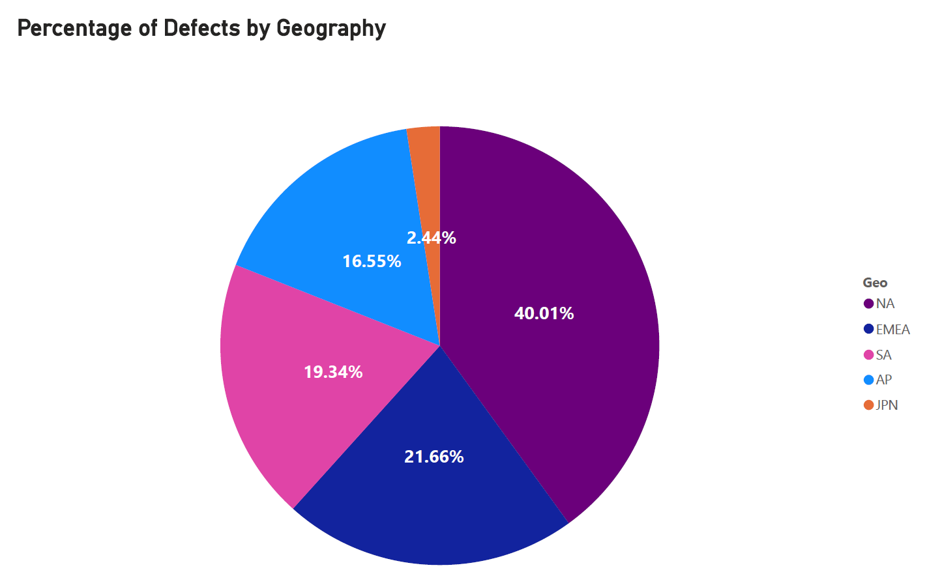
Defect details based on the Geography & Brand
The Japan marketplace boasts the highest performance among all geographies, accounting for only 2.44% of the total defects while achieving an impressive 93.14% SLA compliance. Other marketplaces can benefit from adopting the best practices observed in Japan to enhance their proposal creation processes.

Slide 24
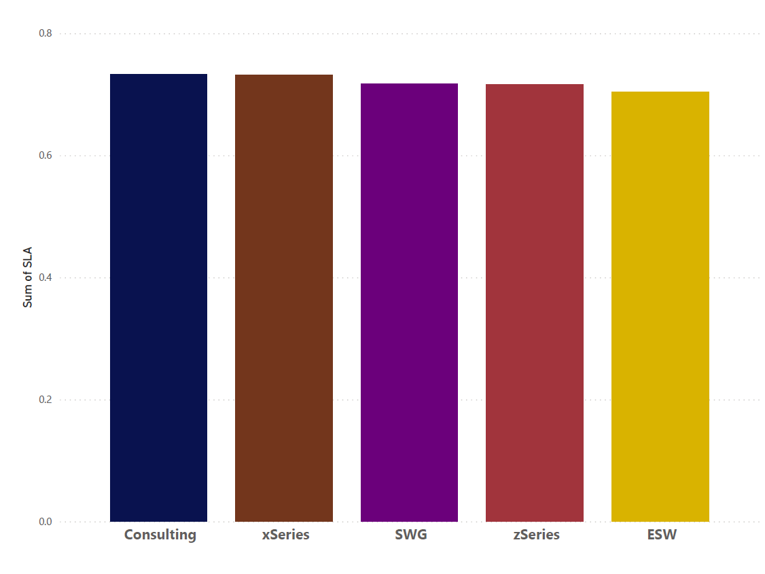
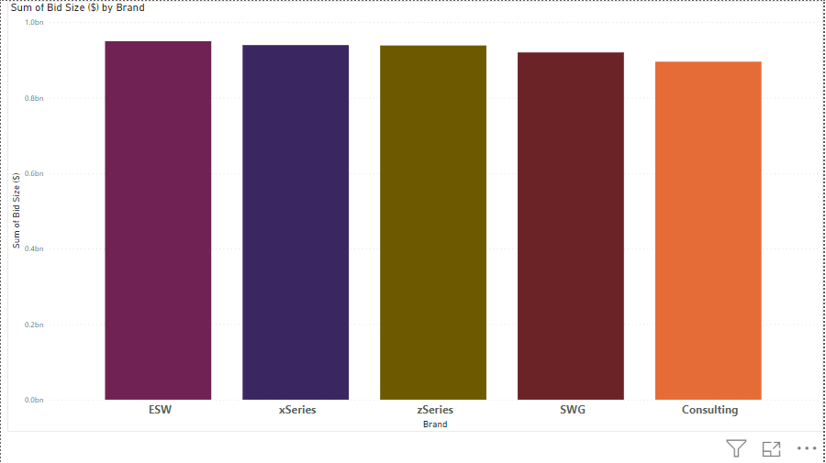
SLA % & Bid Size with respect to the Brands.
SLA %
BRANDS

Slide 25
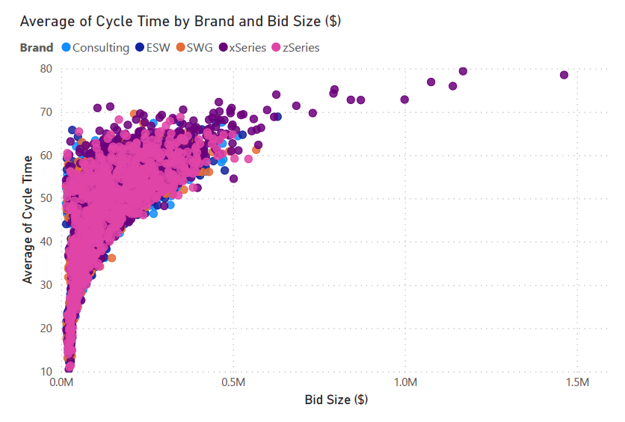
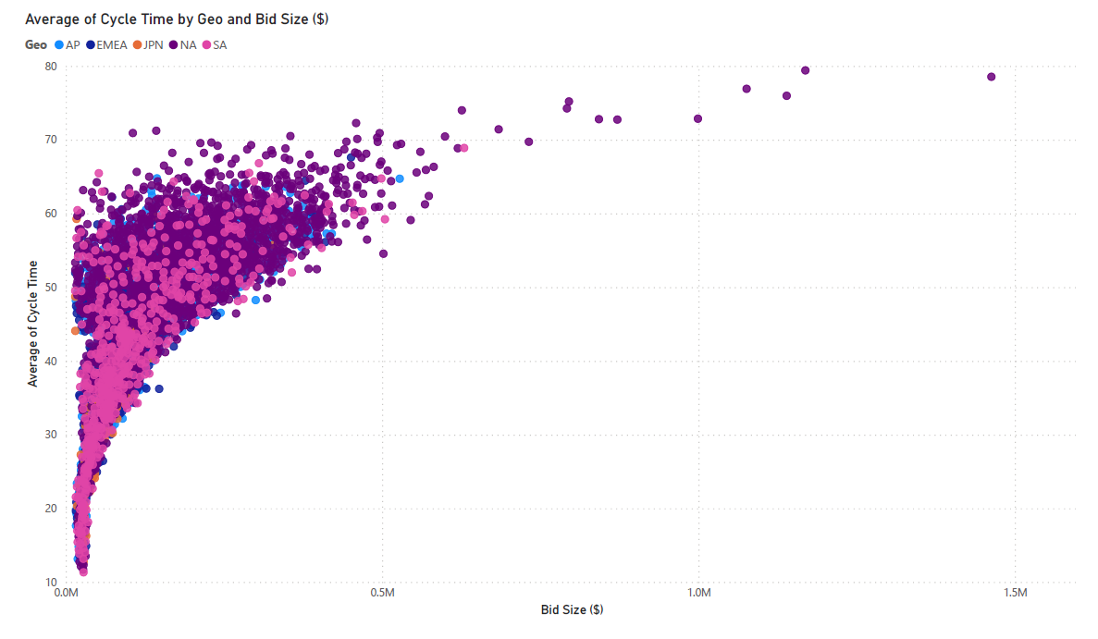
Scatter plot on Cycle time against Bid Size (By both Geolocations & Brand)

Slide 26
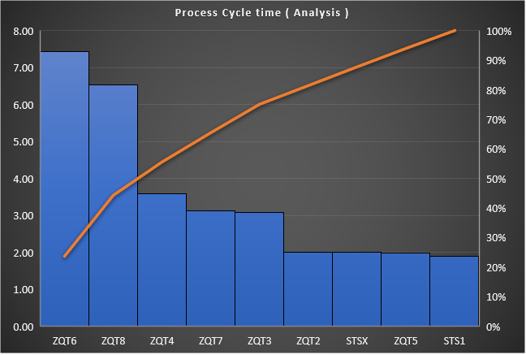
Pareto analysis on the Process Cycle times
Based on Analysis :
ZQT6 process with the redundant process of the re-configuration because it doesn’t meet seller request.
Seller might take more time to come out with the changes or there might be a time conflict with respect to the Geological locations.
ZQT8 – More time taken by the BSS in documentation preparation for each proposal.
Time taken by the Support manager to review the Terms & Conditions of the proposal and sending it to seller.

Slide 27
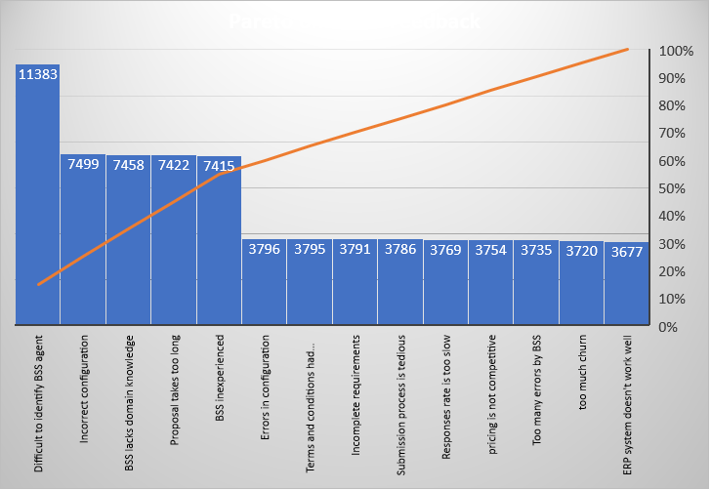
Pareto analysis on the Seller Feed back
Based on Analysis :
15 % of the Feedback on Difficult to identify BSS agent seems to be scope of solution from the STS1 step of the process.
10% of the defects are because of the Incorrect configuration in the ZQT6 process sent by the Design team.
Another 10% on the Proposal takes too long felt by the seller in the process steps of ZQT7 or STSX
And other two mentions that the BSS lack the skill to do the process without enough experience.

Slide 28
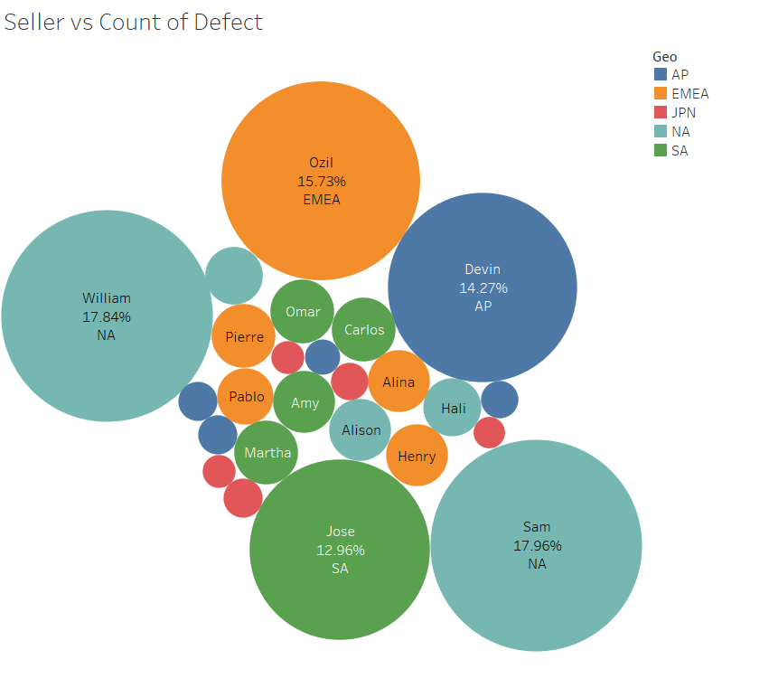
Revenue lost by top 5 Sellers
2.13 Billion
Impacts from the Feedback
Difficult to identify BSS Agent
BSS inexperienced
BSS Lacks domain knowledge

Slide 29
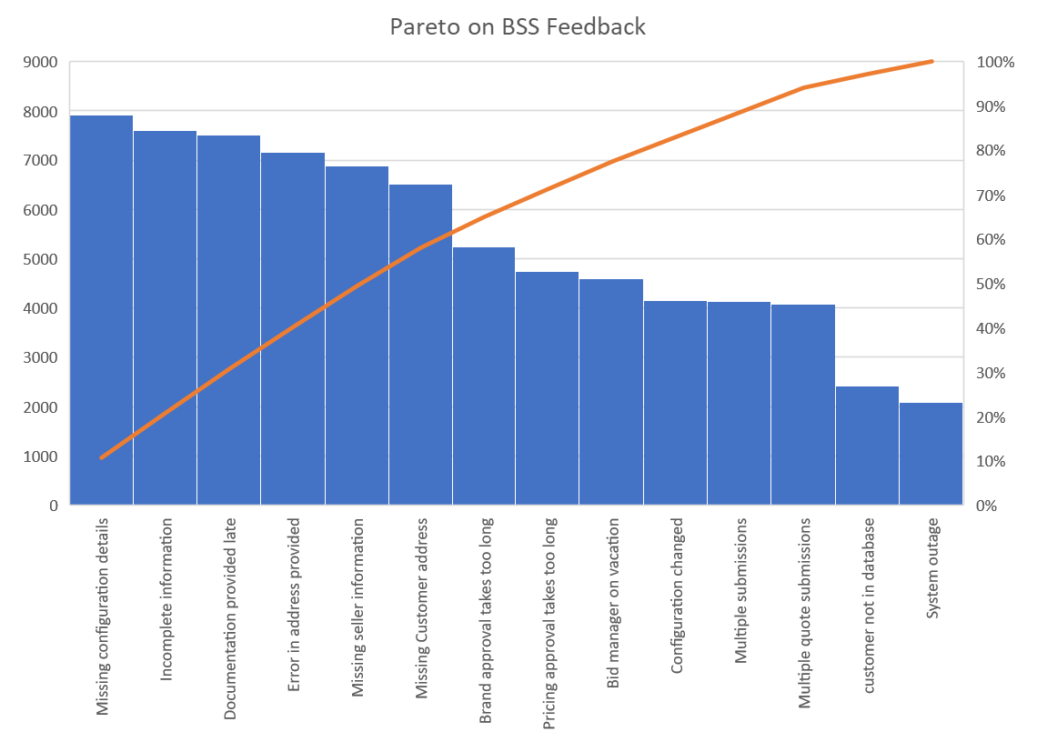
Pareto analysis on the BSS Feedback
Based on Analysis :
Top 3 are the 30% of causes collected from the BSS feedback for the process.
There is a lack of configuration details in the request form for the proposal creation process.
Lack of the information in the request form submitted by the seller in the ERP or BSS.
Documentation is taking long time to submit in the process.

Slide 30
BSS not met the SLA requirement
Based on the Complete SLA % analysis on each BSS :
Japan is generally performing well, with four out of five brands maintaining an SLA percentage greater than 94%. However, the SLA performance of the ESW brand is adversely affected, primarily due to BSS number 58, with a remarkably low 2.04% SLA. This poor performance in the ESW brand is subsequently impacting Japan's overall SLA percentage, bringing it down to 93.07%.
58

Slide 31

5 Why Analysis
18% deduction in Revenue
Increased cycle time in proposal creation process
Redundant reconfiguration increases time.
Current SLA compliance rate is 72.3%
4 out of 5 geographies are performing below 77%
Difficulty in finding the right BSS
5 Sellers from those 4 geographies are performing below 15%
BSS Lacks domain knowledge / inexperienced
Gaps in training and development programs
There is no proper allocation method
Missing key requirements in request form.
Seller is not providing complete information.
The fields were not mandatory.
Quote creation stage is taking 23.5% of overall time.
Seller adds configuration requirements.
Time taken in Documentation part by the BSS
Redundant work in creation of document
Problem
1 Why
2 Why
3 Why
4 Why
5 Why
3.1
4.1
5.1
2.1
1.1
3.2
2.2
4.2
3.3
4.3
5.2
1.2
2.3
3.4
4.4
5.3

Slide 32









PROCESS MAP (Analyzed with pain points)
Defect
Over prod.
Wait time
Non-Utilized Talent
Transportation
Inventory
Motion
Excess process
Request submission stage
Quote Creation process
Pricing stage
Documentation stage
Delivery stage
1 – 11.6 Days
1 – 11.2 Days
1 – 10.8 Days
1 – 18 Days
1 – 17.4 Days
1 – 17.1 Days
1 – 16.6 Days
1 – 11 Days
1 – 17.7 Days
1.9 days
2 days
3 days
3.6 days
2 days
7.4 days
3.1 days
6.5 days
2 days

Slide 33
Fishbone diagram
METHODS
MEASURE
MATERIALS
Too much documentation
Bid value, Quantity incorrect in configuration
Less inventory available
Manual Check of the missing info
EFFECT
Increase in the Overall Cycle time
Incase of natural disasters
BSS is not known to Seller
No advanced system in process
Errors are made in process
Time diff between countries
BSS are less experienced
MOTHER NATURE
MANPOWER
MACHINES

Slide 34
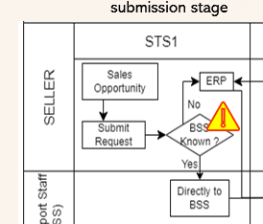
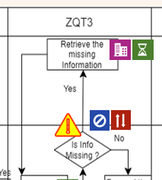
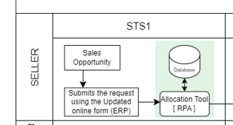
Improvement (Recommended Solution)
To prevent any missing required information and the need for BSS to request it from the seller, we propose adding a mandatory field to the request form (Poka-Yoke – Mistake proofing). This field will be in the form of a dropdown menu for easy selection. – Ref 5WHY – 5.1

Slide 35
Improvement (Recommended Solution)
Integration of Robotic Process Automation (RPA) with the Allocation tool and the form, the system will autonomously allocate the most appropriate Bid Support Staff (BSS). This allocation will be based on factors such as the BSS's domain expertise, Geography, Brand and the bid size, thereby streamlining the allocation process for greater efficiency. – (Ref 5WHY - 5.2)

Slide 36
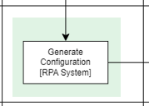
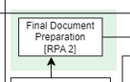
Improvement (Recommended Solution)
ZQT5
Implement RPA bots to extract data from seller requests and analyze them to understand the required configurations. Bots can identify keywords, specifications, and other relevant information to streamline the process. (Ref 5WHY – 5.3)
ZQT8
Utilize document generation software that can automatically populate blurb templates with relevant data. These tools can pull data from your ERP system, databases, or other sources and populate the templates, eliminating the need for manual data entry. (Ref 5WHY – 3.3)

Slide 37

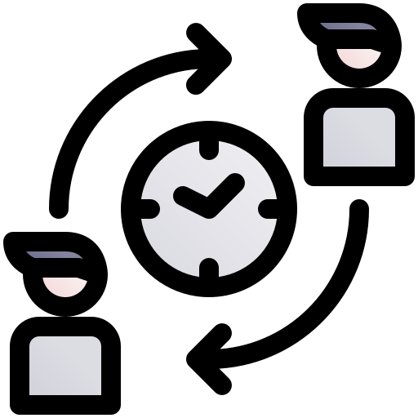
Improvement (Recommended Solution)
Implementing an automated approval template streamlines the request process. When an actor acts on the request, it triggers an automatic assignment to the next responsible person. This efficient system ensures a smooth flow of approvals, reduces delays, and enhances accountability, ultimately optimizing the workflow.
Implement staggered work shifts to provide extended coverage during the working hours of different geographies. This ensures that your team is available to address seller requests in real-time. Hold regular virtual team meetings to coordinate efforts, share best practices, and ensure a unified approach to supporting sellers from various regions.

Slide 38
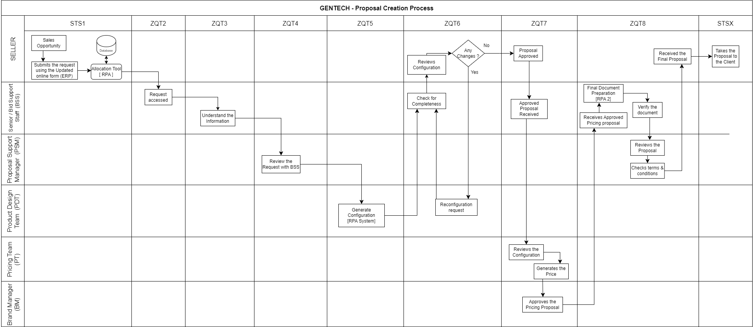
Updated Process Map
Request submission stage
Quote Creation process
Pricing stage
Documentation stage
Delivery stage
1 days
0.5 days
1 days
3.6 days
2 days
5.5 days
3.1 days
5 days
2 days

Slide 39

CONTROL
Set X-bar & R Chart for monthly process cycle time to focus on the Special Cause Variation to investigate the cause to implement the solutions.
Set Control limits for the major time-consuming timestamps.
In ZQT6 – No of defects (In Reconfig.) allowed for Each month.
To set time limits and encourage process efficiency in the Proposal creation process while minimizing errors and reducing customer churn, you can implement a system of reminders and triggers for each timestamp in the approval flow system.
Create a Standard Operating Procedure of the process for the BSS & Seller to be bound & Train each BSS with a Mentor(Sen. BSS)
Maintain the company servers under good preventive maintenance to the process error in the online platform.

Slide 40




Conclusion :
Current Avg cycle time - 31.6 days
Expected Average Cycle time – 23.6 days
Improvement in cycle time by reduction of 25%
Expected SLA % increased from
72.3 % to 89 %.
Cost of investment on the process improvements
1.2 Million
Expected revenue for next year
1.92 Billion

Slide 41
TASK FORCE TEAM
Jeff Hugh
Project Manager
Ben Jose
Project Member
Balaji Raj Veluchamy
Project Member
Omkarini Tirumalaraju
Project Member
Shruthi Reddy Kolan
Project Member

Slide 42

THANK YOU
Team 361 - DATA DYNAMO
Ben Jose
Omkarini Tirumalaraju
Shruthi Reddy Kolan
Balaji Raj Veluchamy

